Slide 1
Autopilot Tips, Tricks and Traps
Paul D’Auria
FAA Gold Seal CFII, MEI
April 1, 2019

Slide 2
What we will cover tonight:
Quick review of GPS buttons and knobs
General autopilot design
Separating the “Brains” from the “Brawn”
Modes of operation
Questions and further reference

Slide 3
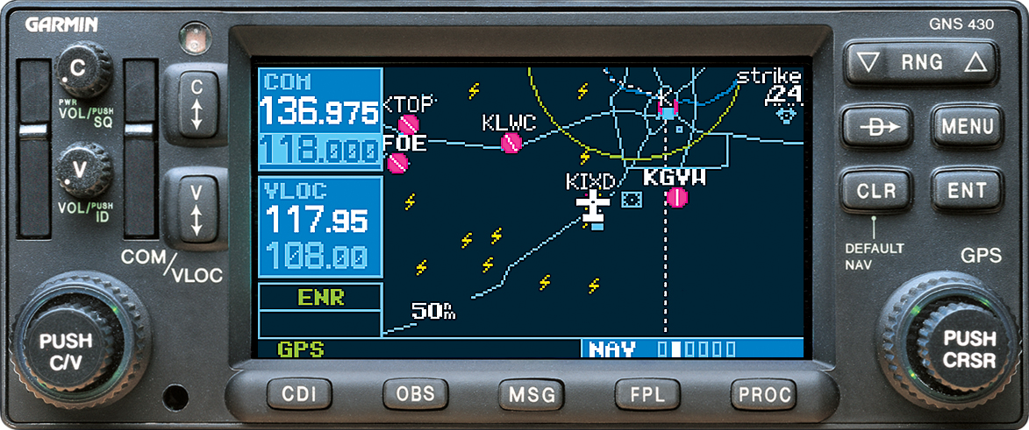
1
2
1
3
1 - Left and right concentric knobs
2 - 5 chapters (4 on knob, one on FPL button)
3 - CDI OBS buttons (we’ll revisit tonight)

Slide 4
General Autopilot Design and Flow
Roll servo
Pitch servo

Slide 5
General Autopilot Design and Flow
Roll servo
Pitch servo

Slide 6
General Autopilot Design and Flow
Roll servo
Pitch servo

Slide 7
General Autopilot Design and Flow
CDI Button
Roll servo
Pitch servo

Slide 8
Autopilot without GPS Roll Steering
CDI Button
Roll servo
Pitch servo

Slide 9
STEC 30 Autopilot
Skylane 736RE
Skyhawk 642SP

Slide 10
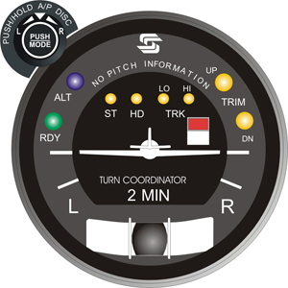
STEC 30 Autopilot
Stabilization Mode
Heading Mode
Track Mode
CDI Button

Slide 11
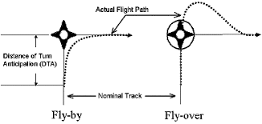
With GPSS Steer
W/O GPSS Steer

Slide 12
With GPSS Steer
W/O GPSS Steer

Slide 13
STEC 30 Autopilot
GPSS
HDG
CDI Button

Slide 14
Autopilot without GPS Roll Steering
CDI Button
Roll servo
Pitch servo

Slide 15
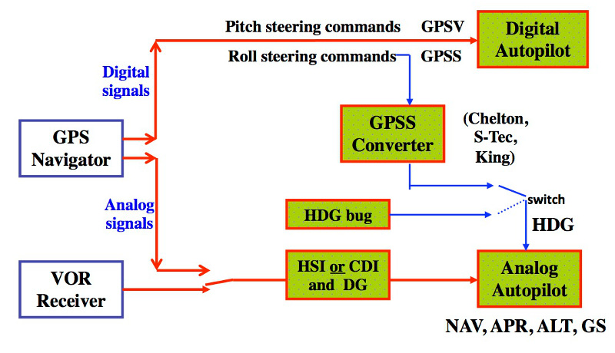
Autopilot with GPS Roll Steering
GPSS
HDG
CDI Button
Roll servo
Pitch servo

Slide 16
STEC 30 Tricks and Traps
A/P must be in HDG mode when using GPS Steer
If GPSS Light is blinking, check A/P mode and CDI button
Remember to trim first before using ALT Hold button, and listen continuously for trim warnings

Slide 17
KAP 140 Autopilot
Diamond 263DS

Slide 18
Controls and Indications
BENDIX/KING
KAP 144
HDG
AP
ALT
500
ARM
BARO
P
T
ALERT FT
UP
P
R
AP
HDG
NAV
APR
REV
ALT
DN
No master switch (autopilot starts with avionics master)
Autopilot engage/disengage button - must be pressed and held
Turns AP on in default ROL (wing leveler) and VS mode
Turns AP off

Slide 19
Controls and Indications
BENDIX/KING
KAP 144
HDG
AP
ALT
500
ARM
BARO
P
T
ALERT FT
UP
P
R
AP
HDG
NAV
APR
REV
ALT
DN
Heading mode selector button
Selects heading mode
Turns airplane to maintain heading under heading bug
Used to toggle between ROL and Heading mode

Slide 20
Controls and Indications
BENDIX/KING
KAP 144
HDG
AP
ALT
500
ARM
BARO
P
T
ALERT FT
UP
P
R
AP
HDG
NAV
APR
REV
ALT
DN
Navigation mode selector button
Automatic capture of and tracking of VOR, LOC, or GPS signals set on HSI
Recommended for enroute navigation

Slide 21
With HSI Twist
W/O GPSS Steer

Slide 22
Controls and Indications
BENDIX/KING
KAP 144
HDG
AP
ALT
500
ARM
BARO
P
T
ALERT FT
UP
P
R
AP
HDG
NAV
APR
REV
ALT
DN
Altitude hold mode selector button
Toggles between ALT HOLD and VS mode

Slide 23
Controls and Indications
BENDIX/KING
KAP 144
HDG
AP
ALT
500
ARM
BARO
P
T
ALERT FT
UP
P
R
AP
HDG
NAV
APR
REV
ALT
DN
Vertical speed mode buttons
Action of button depends on AP mode when selected
When in VS mode, momentary press will show captured VS
Subsequent presses will change target VS by 100 ft.. per min
When in ALT mode, a momentary press will adjust the ARMed altitude 20 ft. (display will not change)

Slide 24
Controls and Indications
BENDIX/KING
KAP 144
HDG
AP
ALT
500
ARM
BARO
P
T
ALERT FT
UP
P
R
AP
HDG
NAV
APR
REV
ALT
DN
Altitude Arm button
Toggles altitude capture on (ALT ARM annunciated) and off
When armed AP will capture altitude displayed in alerter, if the current VS will direct an intercept.
Upon capturing altitude, the AP is armed for a new altitude

Slide 25
Controls and Indications
BENDIX/KING
KAP 144
HDG
AP
ALT
500
ARM
BARO
P
T
ALERT FT
UP
P
R
AP
HDG
NAV
APR
REV
ALT
DN
Barometric pressure button
Push to display baro setting.
Large and small knobs are then used to set the desired current barometric pressure

Slide 26
Controls and Indications
BENDIX/KING
KAP 144
HDG
AP
ALT
500
ARM
BARO
P
T
ALERT FT
UP
P
R
AP
HDG
NAV
APR
REV
ALT
DN
Rotary Knobs
Used to set the altitude alerter
After pressing BARO button, knobs are used to set current barometric pressure

Slide 27
Controls and Indications
BENDIX/KING
KAP 144
HDG
AP
ALT
500
ARM
BARO
P
T
ALERT FT
UP
P
R
AP
HDG
NAV
APR
REV
ALT
DN
Altitude Alerter/vertical speed/BARO setting display
Displays altitude for altitude alerter. This is the ARMed altitude, chime sounds when 1000ft and 200 ft. from altitude
Shows captured or set VS after pressing UP/DN key
Shows BARO setting after pressing BARO

Slide 28
Controls and Indications
BENDIX/KING
KAP 144
HDG
AP
ALT
500
ARM
BARO
P
T
ALERT FT
UP
P
R
AP
HDG
NAV
APR
REV
ALT
DN
Pitch Trim annunciator
Indicates direction of trim
Flashes if trim is not satisfied in 10 seconds
Solid PT without an arrow is an indication of a fault

Slide 29
Controls and Indications
BENDIX/KING
KAP 144
HDG
AP
ALT
500
ARM
BARO
P
T
ALERT FT
UP
P
R
AP
HDG
NAV
APR
REV
ALT
DN
Autopilot engagement annunciator
On whenever AP is on
Flashes during pilot initiated or automatic disconnect

Slide 30
Controls and Indications
BENDIX/KING
KAP 144
HDG
AP
ALT
500
ARM
BARO
P
T
ALERT FT
UP
P
R
AP
HDG
NAV
APR
REV
ALT
DN
Pitch (P) and Roll (R) axis annunciator
Indicates failure of illuminated axis
In turbulent air P may illuminate during abnormal accelerations

Slide 31
Controls and Indications
Top row: Shows what is active
BENDIX/KING
KAP 144
HDG
AP
VS
3500
ARM
BARO
P
T
ALT
ALERT FT
UP
NAV
ARM
P
R
ARM
AP
HDG
NAV
APR
REV
ALT
DN
Bottom row: Shows what is armed

Slide 32
Controls and Indications
Desired level off altitude
BENDIX/KING
KAP 144
NAV
AP
ALT
3500
ARM
BARO
P
T
ALERT FT
UP
P
R
AP
HDG
NAV
APR
REV
ALT
DN
VS changes to ALT to show the
preset altitude has been captured
ALT ARM is extinguished
when the preset altitude
is captured

Slide 33
KAP 140 Tricks and Traps
More limitations than STEC 30:
Maximum flaps: T/O position
Must be disengaged below 200 ft. AGL on approach, and below 800 ft. AGL for other phases of flight
AP must be off for T.O. and landing
Never engage above 165 KIAS, or below 70 KIAS

Slide 34
KAP 140 Tricks and Traps
Key differences vs. STEC 30:
ROL (vs. ST) mode will hold current pitch attitude too
Not GPSS-equipped
Can pre-arm next mode
You MUST turn the HSI to new desired course over each waypoint to enable turn anticipation and proper steering

Slide 35
Sources / Attribution / Further Reference
STEC Pilot’s Operating Handbook, 3rd Edition
STEC GPSS Pilot’s Operating Handbook, 5th Edition
KAP 140 Pilot’s Guide, Revision 3
Midwest Flyer Magazine February / March 2012, “GPSS or Roll Steering on Autopilots”, by Michael Kaufman (http://midwestflyer.com)
Prusak, Michael, Lt. Col USAF, “KAP 140 Operation Procedures”, w add’l adaptations by T. Halvorson and R. Harris (blueskyaa.com/members)
www.youtube.com/watch?v=p0_IlpbS0iw, “STEC 30 Autopilot Operation”

Slide 36
Questions?

Slide 37
Supplemental Information

Slide 39
Preflight
BARO Setting flashing – Set current local barometer
Autopilot - Engage
Flight Controls – Move (Ensure autopilot can be overpowered
A/P DISC/TRIM Switch – Push (Autopilot disengages warning tone heard)
Elevator Trim- Set for take off
Before Takeoff Check
A/P DISC/TRIM Switch – Push
BARO –Set
ALTITUDE Select – Set
If autopilot test fails the airplane may be flown if the Autopilot Circuit Breaker is opened
Use knobs to select level off altitude in Altitude Alerter for first altitude desired

Slide 40
After Takeoff Climb
Trim aircraft and set stable airspeed and climb
After 800 ft. AGL and wings level, turn on AP by pressing AP button
AP will be in ROL and VS mode and displayed on face plate
Momentarily press UP/DN key to display captured VS rate
AP will capture the rate at the time the AP is turned on
A high climb rate could lead to a stall
Adjust the VS rate as required by pressing UP or DN as required
Use knobs to select level off altitude in Altitude Alerter (should be set before TO)
Arm Altitude Alerter by pressing “ARM”
Turn HSI heading bug to desired intercept heading (may be set before TO)
Press HDG button to turn to desired heading
Press CDI soft key on GPS as required to select desired Nav mode (VLOC or GPS)
Press NAV key to arm AP to capture and fly the desired course

Slide 41
After Takeoff Climb
BENDIX/KING
KAP 144
ROL
AP
VS
3500
ARM
BARO
P
T
ALERT FT
UP
P
R
AP
HDG
NAV
APR
REV
ALT
DN
VS (vertical speed)
Captures rate of climb
when AP was turned on
Press AP button
to turn on autopilot
ROL (roll mode) or
wing level mode
Altitude set in
Altitude Alerter
(Level off altitude)

Slide 42
After Takeoff Climb
Momentarily press
UP or DN button
BENDIX/KING
KAP 144
ROL
AP
VS
500
ARM
BARO
P
T
ALERT FT
UP
P
R
AP
HDG
NAV
APR
REV
ALT
DN
Momentarily displays the
captured rate of climb/descent

Slide 43
Indications During After Takeoff Climb
Press ARM to arm the AP to
level off at the preset “Altitude
Alerter” (level off) altitude
BENDIX/KING
KAP 144
ROL
AP
VS
3500
ARM
BARO
P
T
ALT
ALERT FT
UP
P
R
ARM
AP
HDG
NAV
APR
REV
ALT
DN
ALT ARM will be displayed
to show the AP is armed to
capture the preset altitude
Altitude Alerter (level-off)
altitude

Slide 44
Indications During After Takeoff Climb
Press HDG to make the AP turn
to the heading under the heading
bug on the HSI
BENDIX/KING
KAP 144
HDG
AP
VS
3500
ARM
BARO
P
T
ALT
ALERT FT
UP
P
R
ARM
AP
HDG
NAV
APR
REV
ALT
DN
Display will switch from ROL to HDG
and aircraft will turn to selected heading

Slide 45
Indications During After Takeoff Climb
BENDIX/KING
KAP 144
HDG
AP
VS
3500
ARM
BARO
P
T
ALT
ALERT FT
UP
NAV
ARM
P
R
ARM
AP
HDG
NAV
APR
REV
ALT
DN
NAV ARM will be displayed
showing that the AP is armed
to capture and intercept the
course selected on the HSI
Press NAV button to arm
NAV capture

Slide 46
Indications During After Takeoff Climb
Indicator will change from HDG to NAV
when the HSI course is captured
BENDIX/KING
KAP 144
NAV
AP
VS
3500
ARM
BARO
P
T
ALT
ALERT FT
UP
P
R
ARM
AP
HDG
NAV
APR
REV
ALT
DN
NAV ARM will disappear when the
course is captured

Slide 47
Level off- Cruise
After level off, prior to approach and throughout flight, reset baro setting. Reset altitude select/altitude alerter altitude to the next desired altitude.
ARM does not have to be reselected
If an enroute climb or descent is required, select VS mode by pressing ALT key (Toggles the AP from capture of the current altitude and VS mode).
Use UP/DN key as needed to select the desired rate of climb .
During a climb in the VS mode, the current altitude can be captured by pressing the ALT key regardless of what is set in the altitude select/alerter

Slide 48
Indications after Level Off
Set the next desired altitude
(normally IAF altitude)
BENDIX/KING
KAP 144
NAV
AP
ALT
3000
ARM
BARO
P
T
ALT
ALERT FT
UP
P
R
ARM
AP
HDG
NAV
APR
REV
ALT
DN
ALT ARM will be displayed
showing the AP is armed to
capture the next altitude
Note: ARM is not pressed
ALT is still displayed showing
that the previous altitude is
still captured

Slide 49
Indications During Descent
Rate of descent
momentarily displayed
BENDIX/KING
KAP 144
HDG
AP
VS
-300
ARM
BARO
P
T
ALT
ALERT FT
UP
APR
ARM
P
R
ARM
AP
HDG
NAV
APR
REV
ALT
DN
Press DN key to select
desired rate of descent
Press ALT to toggle
to VS mode
VS displayed

Slide 50
Indications During Approach - GPS
BENDIX/KING
KAP 144
NAV
AP
VS
3000
ARM
BARO
P
T
ALT
ALERT FT
UP
P
R
ARM
AP
HDG
NAV
APR
REV
ALT
DN
During a GPS approach, when you are turned on course to the FAF (Track and Desired Track are within 10°), a message will prompt you to enable the autopilot outputs before using the autopilot for an approach: “APR Guidance Available Use PROC before A/P APR”. Press the procedure (PROC) button and the curser defaults to “Enable A/P APR Outputs?” Press enter (ENT) to provide vertical and lateral GPS approach guidance to the autopilot. Now select approach (APR) on the autopilot. The autopilot will capture both the lateral course and the GPS glidepath.

Slide 51
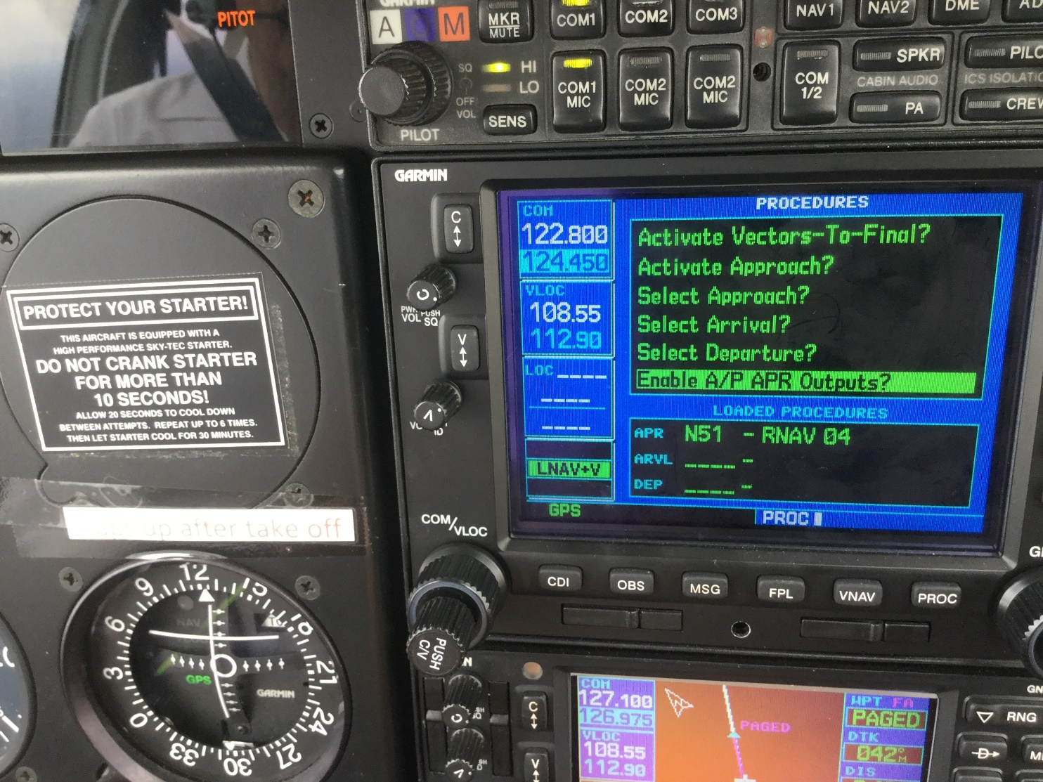
Indications During Approach - GPS

Slide 52
Effects of Equipment Failure
Failure of Attitude Indicator – No effect
Failure of DC turn coordinator - Autopilot disengages
Failure of HSI – No heading signal so ROL mode only
Failure of Transponder pressure encoder - Altitude alerter/preset fails
Failure of Trim servo – Auto pilot provides warning tone and disconnects – Manually control aircraft and then Press red dis-engage button to silence tone and pull autopilot circuit breaker

